Slide 1

Credit Card Recommender & Sentiment Analysis
Brought to you by:

Slide 2
Agenda
01
02
03
04
05
06
Introduction
EDA
Background and
Problem Statement
Exploratory Data Analysis
Sentiments
Modeling
Sentiment Analysis using BERT
Model Evaluation
Product Demo
Conclusion
Demonstration
Further Enhancements

Slide 3

INTRODUCTION

Slide 4
BACKGROUND
All credit cards in Singapore offer some sort of reward for using them for your purchases. (E.g. Cashback / Miles)
Cashback refers to receiving back a percentage of what you spend in the form of money.
Miles refers to rewards points which can be converted to Miles (eg. Krisflyer) which can be use to buy flight tickets.

Slide 5



PROBLEM STATEMENT
What steps do you take to decide which is the best card for you?
Visit a personal finance website

Slide 6
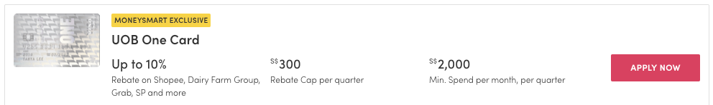
PROBLEM STATEMENT
What steps do you take to decide which is the best card for you?
Look for a card that you think best suits you
** Extracted from MoneySmart

Slide 7
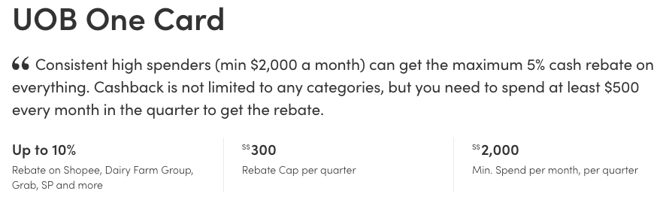
PROBLEM STATEMENT
What steps do you take to decide which is the best card for you?
Click in
** Extracted from MoneySmart

Slide 8
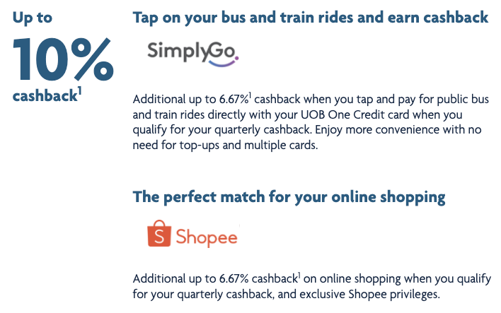
PROBLEM STATEMENT
What steps do you take to decide which is the best card for you?
Read through all the terms and conditions in the card’s site

Slide 9
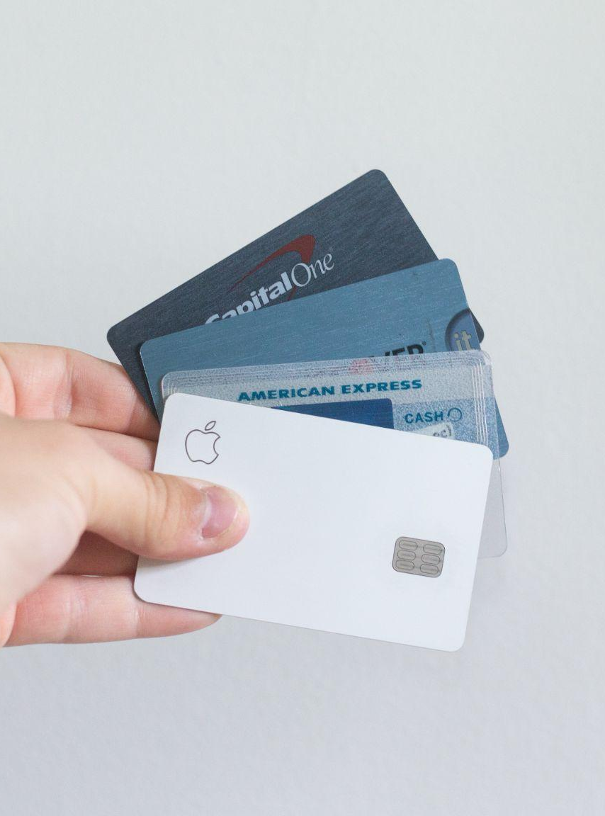
PROBLEM
STATEMENT
Choosing a best credit card that best suits your spending needs is time consuming and complicated.

Slide 10


OBJECTIVES
Use Data Science techniques to create a credit card recommender
Make use of the findings to analyse reviews on cards to find out the sentiments on each of these cards.

Slide 11

EXPLORATORY DATA ANALYSIS

Slide 12
DATA COLLECTION & CLEANING
Scraped list of cards and reviews from various sites using BeautifulSoup and Selenium.
Scrapped a total of 117 cards and 1,093 reviews
Apply preprocessing techniques to prepare the dataset for EDA:
Remove punctuations
Tokenize the reviews
Remove common stop words such as I, We, etc
Lemmatize the words

Slide 13
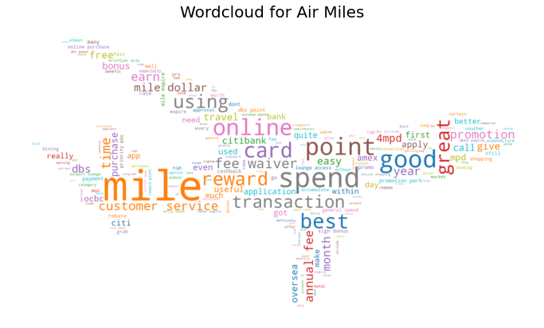
MOST COMMON WORDS
Miles Cards:
Mile
Spend
Point
Fee
Online
DBS

Slide 14
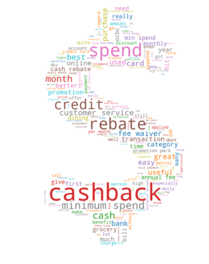
MOST COMMON WORDS
Cashback Cards:
Cashback
Spend
Rebate
Month
Credit
Cash

Slide 15
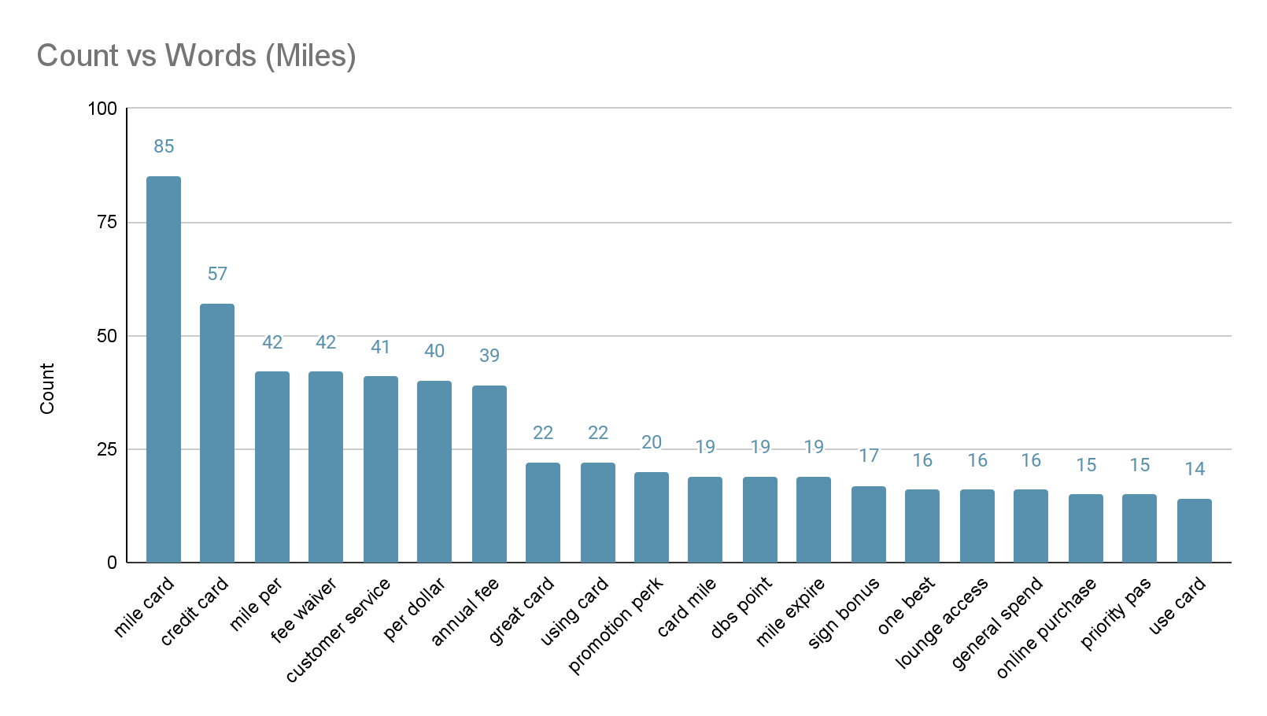
BIGRAM - MILES

Slide 16
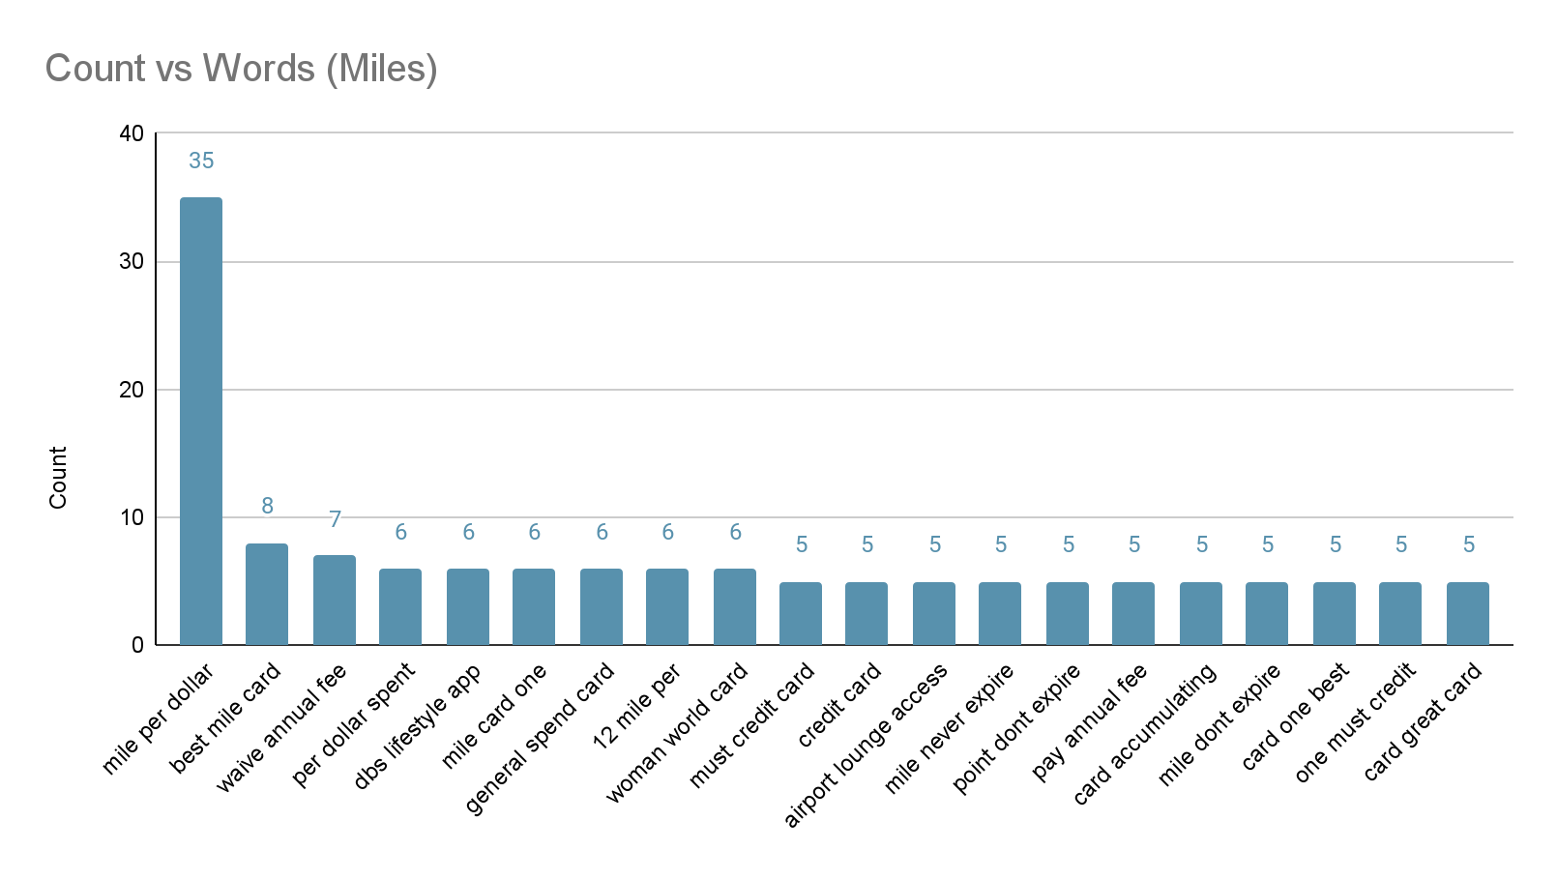
TRIGRAM - MILES

Slide 17
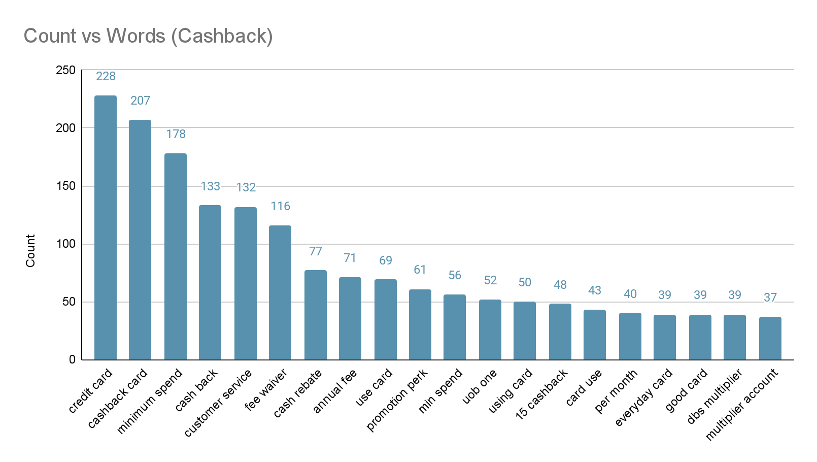
BIGRAM - CASHBACK

Slide 18

TRIGRAM - CASHBACK

Slide 19
SENTIMENT ANALYSIS

Slide 20
SENTIMENT ANALYSIS - BERT
Open source machine learning framework for NLP that is developed and trained by Google
Pre-trained using text from Wikipedia
Pre-trained model trained on 150k product reviews
Predicts the sentiment of the review as a number of stars (1 - 5 stars)
Model accuracy of 67% (exact) and 95% (off by 1)

Slide 21
SENTIMENT ANALYSIS - NPS
Calculate Net Promoter Score (NPS) using sentiment scores
Benchmark measures customer experience
How likely is it that you would recommend [brand] to a friend or colleague?
% of Promoters - % of Detractors
1 | 2 | 3 | 4 | 5
Detractor
Passive
Promoter

Slide 22
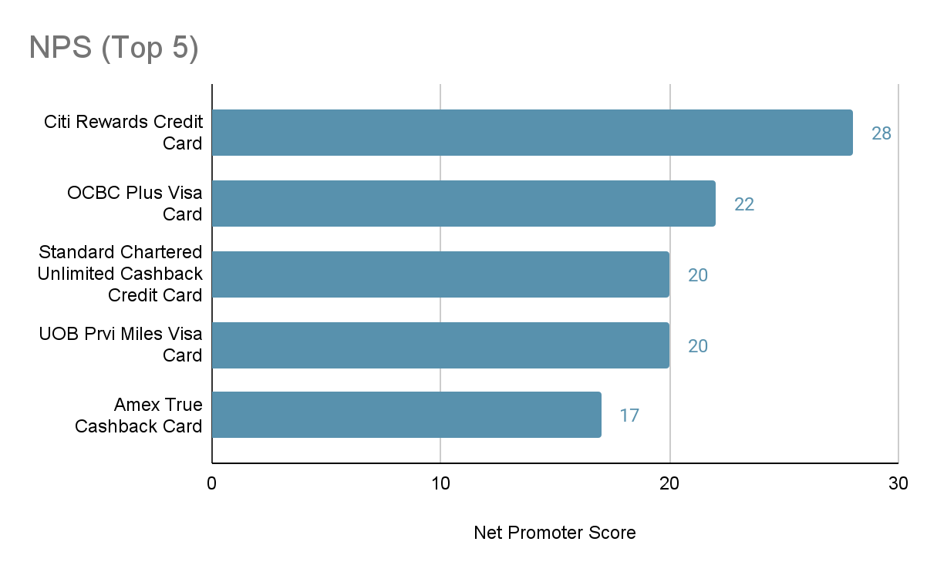
SENTIMENT ANALYSIS - CARDS
Cards with the highest NPS:

Slide 23
SENTIMENT ANALYSIS - CARDS
Sample top reviews:
“Great card which I have been using for some time. Good interest rate and no minimum spending. Lots of rewards.”
“10% cashback max for Grab services, Cold storage, 7 eleven and Shopee! The best credit card in the market right now in my opinion, where else can you get 10% cashback”
“This card is very good for rebates while spending. Friendly Customer service and always waive the annual fee for and many more benefits. Will recommend to friends and family.”

Slide 24
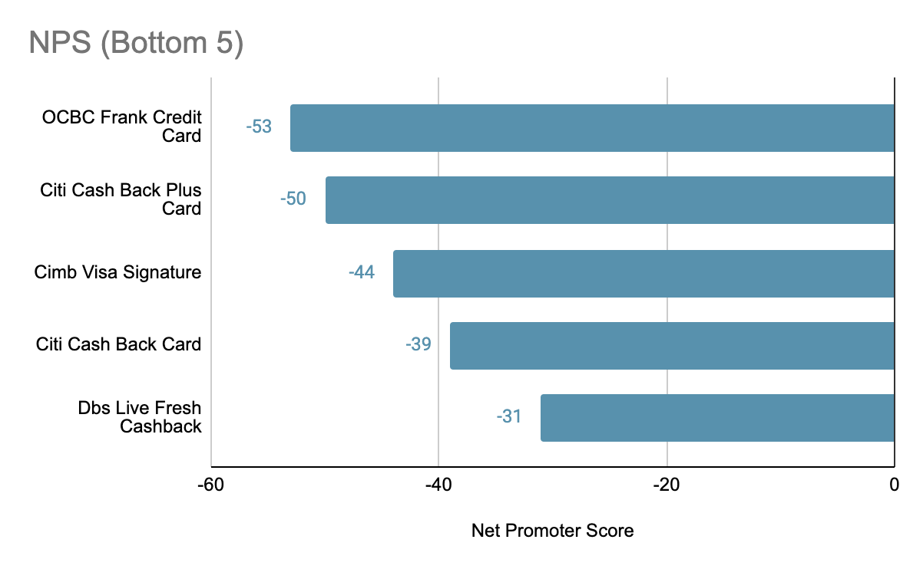
SENTIMENT ANALYSIS - CARDS
Cards with the lowest NPS:

Slide 25
SENTIMENT ANALYSIS - CARDS
Sample negative reviews:
“DO NOT use ocbc credit cards! They move forward your statement due date and are super inflexible with waivers (even if only 1 day late AND before the original due date!) I got charged $100 late fee only a $100 bill! This is how they earn money, not through providing proper services!”
“There is ZERO customer service. And they punish you with hefty credit fees at such a difficult time for not using their credit card enough. There is nothing about this bank that is worth considering. Consider this a fair warning for all new applicants.”

Slide 26
Modeling

Slide 27
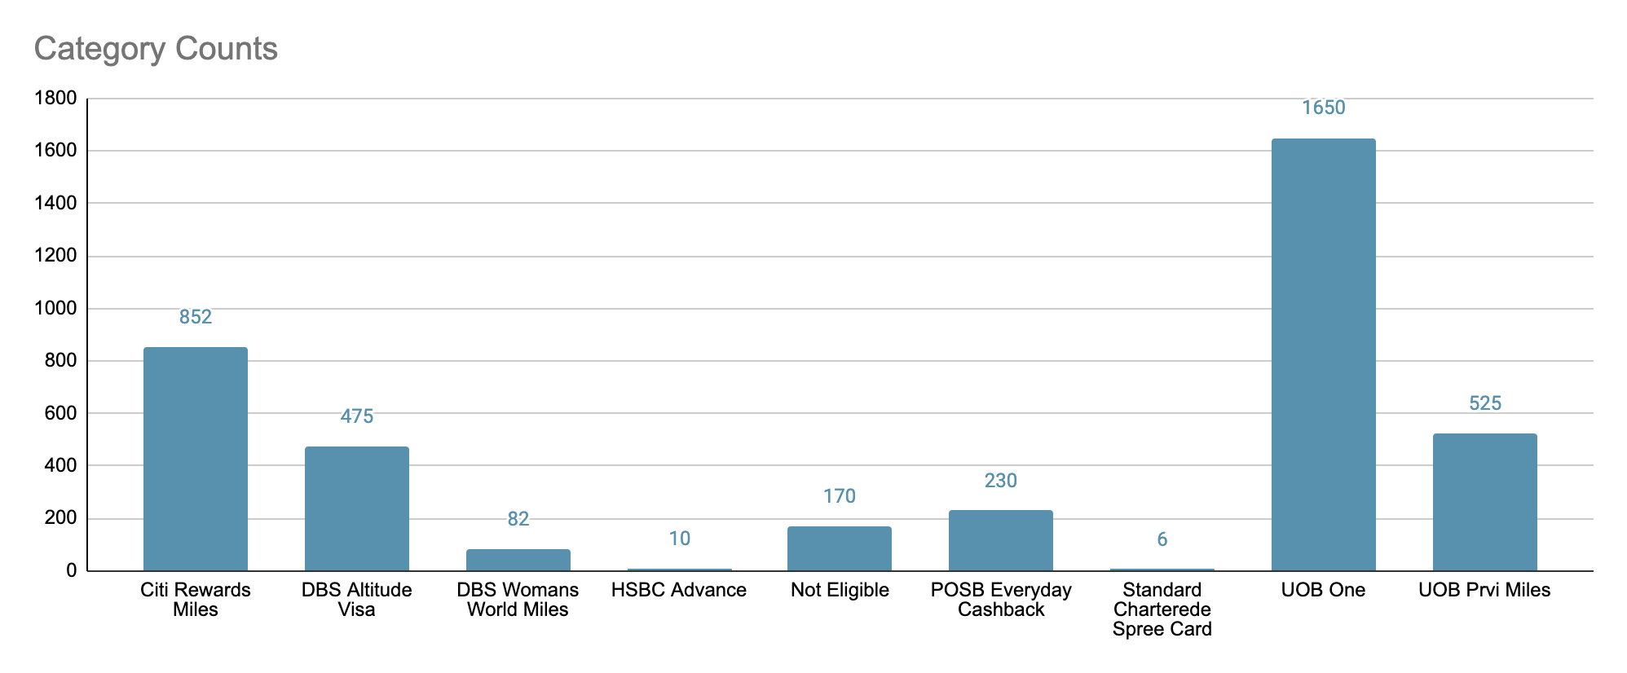
MODELING
Objective: Use Supervised Classification Models to classify customers’ input and recommend a best card
Dataset: 4,000 randomised inputs based on a questionnaire

Slide 28
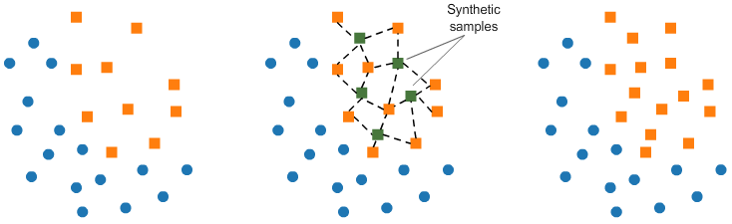
MODELING - SMOTE
Synthetic Minority Oversampling Technique (SMOTE) is an oversampling technique where the synthetic samples are generated for the minority class. This will help to balance our data in order to aid our machine learning algorithms.

Slide 29

MODELING - MODEL RESULTS
Model | Without GridSearchCV |  | With GridSearchCV |  | Runtime
 | Train | Test | Train | Test
K Nearest Neighbour Classifier (Baseline) | 0.742 | 0.711 | 0.801 | 0.763 | 1 sec
Random Forest Classifier | 0.943 | 0.934 | 0.941 | 0.931 | 1 sec
Ada Boost Classifier | 0.752 | 0.456 | 0.869 | 0.821 | 2 sec
Gradient Boost Classifier | 0.953 | 0.938 | 0.949 | 0.944 | 10 sec
Gradient Boost Classifier is the best performing model
However, we have selected Random Forest Classifier as our preferred model

Slide 30

Product Demo

Slide 31

PRODUCT DEMO
Link: https://keycards.herokuapp.com/
Scenario:
Name: Mr Llama
Income: $65,000 per year
Preferred Card: Miles
Takes public transport ($100 per mth)
Groceries ($200 per mth)
Online shopping ($300 per mth)
Preferred Travel Partner: Krisflyer

Slide 32
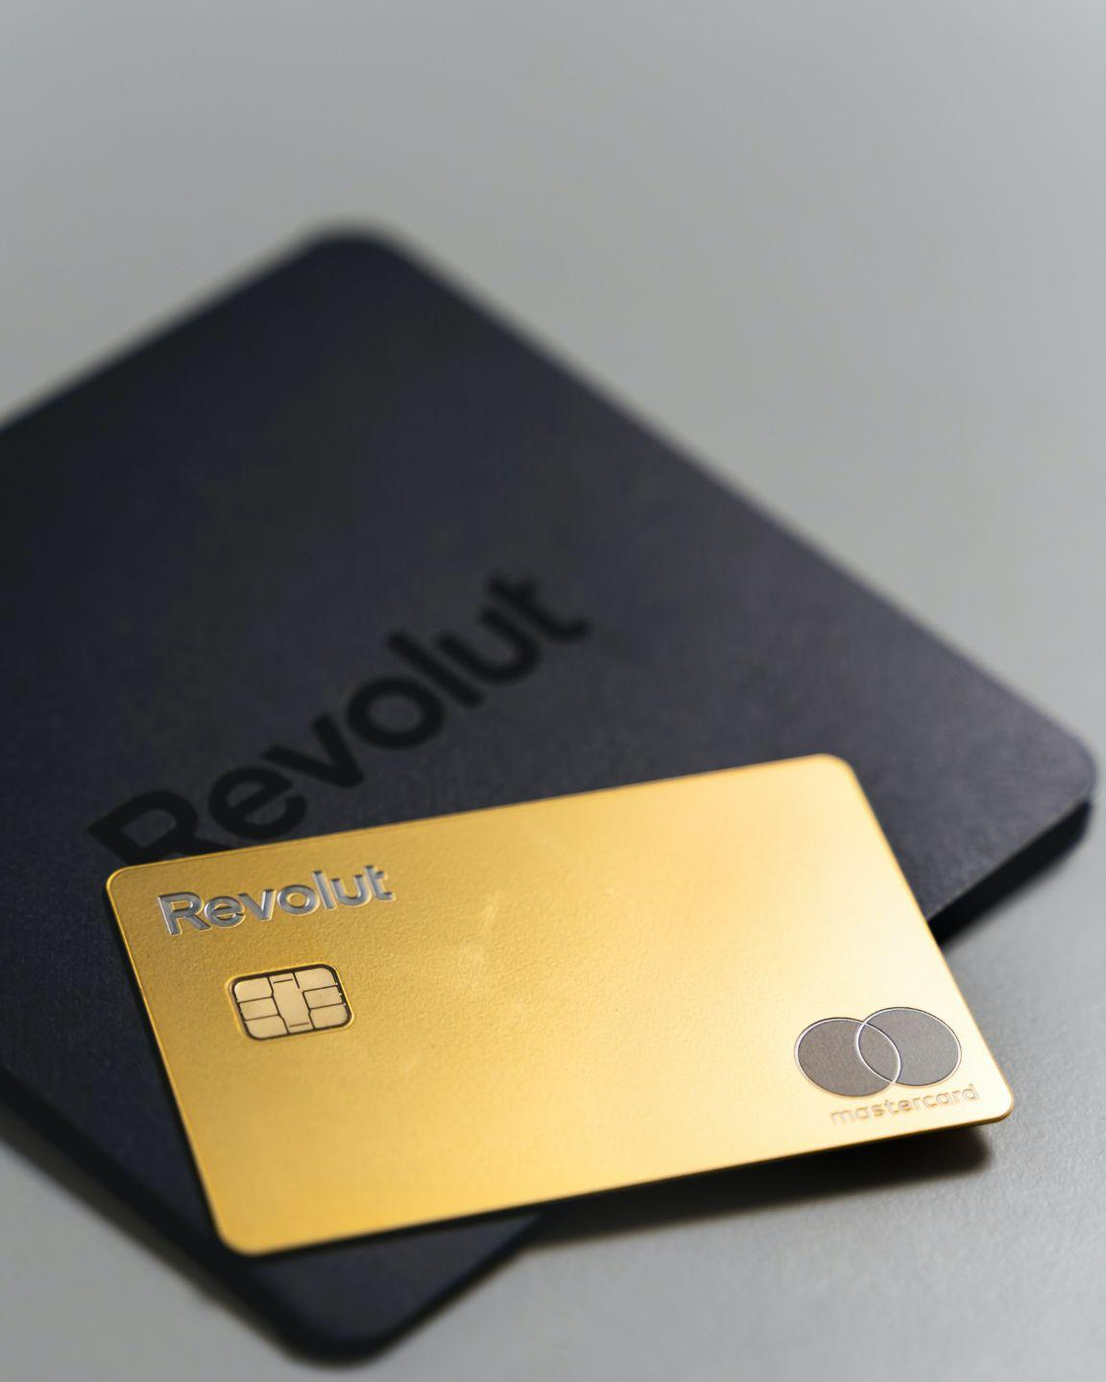
Conclusion

Slide 33


FUTURE ENHANCEMENTS
More Data
More Cards
Other Locations
More reviews
from other sites
More cards to be included in the recommender
Scale to other countries

Slide 34
CONCLUSION
Demo Link: https://keycards.herokuapp.com/
Key Takeaways:
Recommender is fuss free way to select the best suited credit cards
Besides return, customers service is also quite an important factor when determining a good credit card

Slide 35

Thank you!
Brought to you by:

